Slide 1



Creating Data Repositories for sports based on
video/image data
STARC '23

Slide 2


01
ABOUT US
SHUBHAM MOOKIM
YASH KUMAR
SHUSHANTH PREM ANAND

Slide 3
Why we did this ?
The lack of publicly available, curated datasets in multiple sports hinders progress in sports analytics research and development. A research area that could address this issue is the development of efficient and standardized methods for collecting and curating large volumes of sports data, with a focus on ensuring:
data quality,
privacy,
security.

Slide 4
How are we doing this?
02
Using Advanced Large Language model such as Minigpt-4
MiniGPT-4 consists of a vision encoder with a pretrained ViT and Q-Former, a single linear projection layer, and an advanced Vicuna large language model.

Slide 5
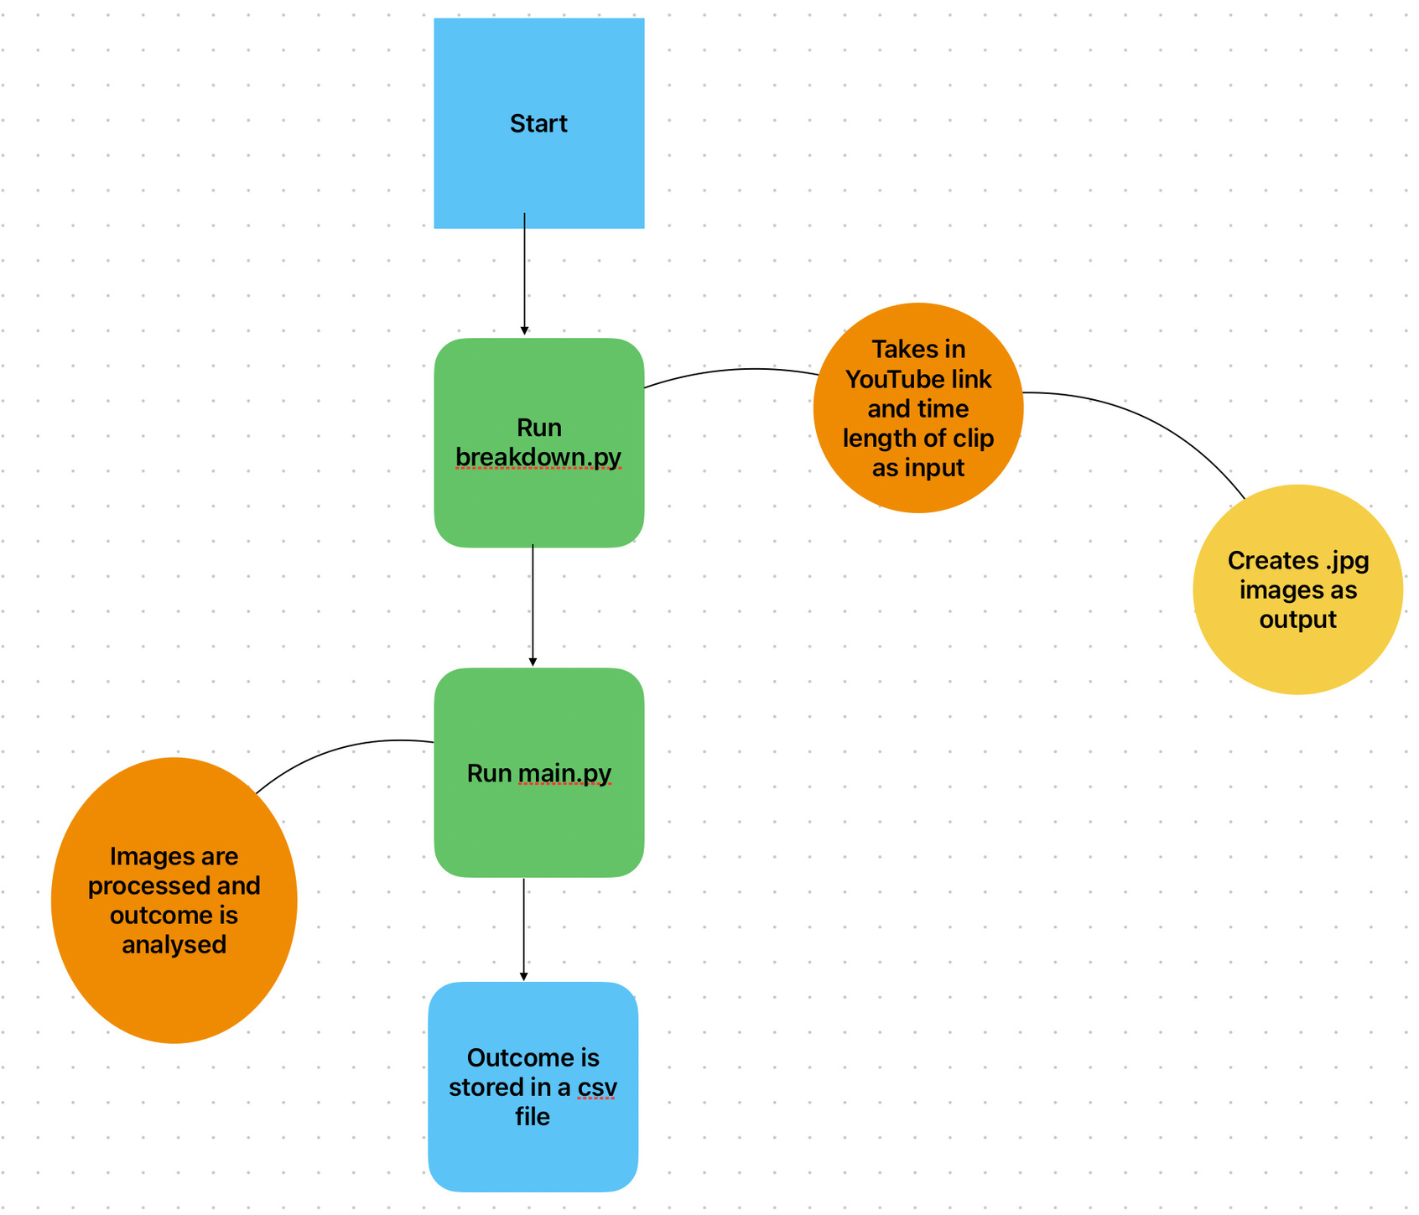

Slide 6
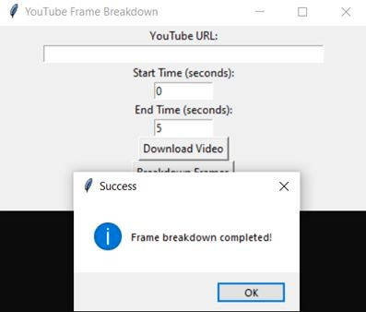
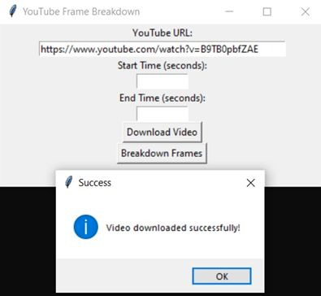
Program snippets:

Slide 7
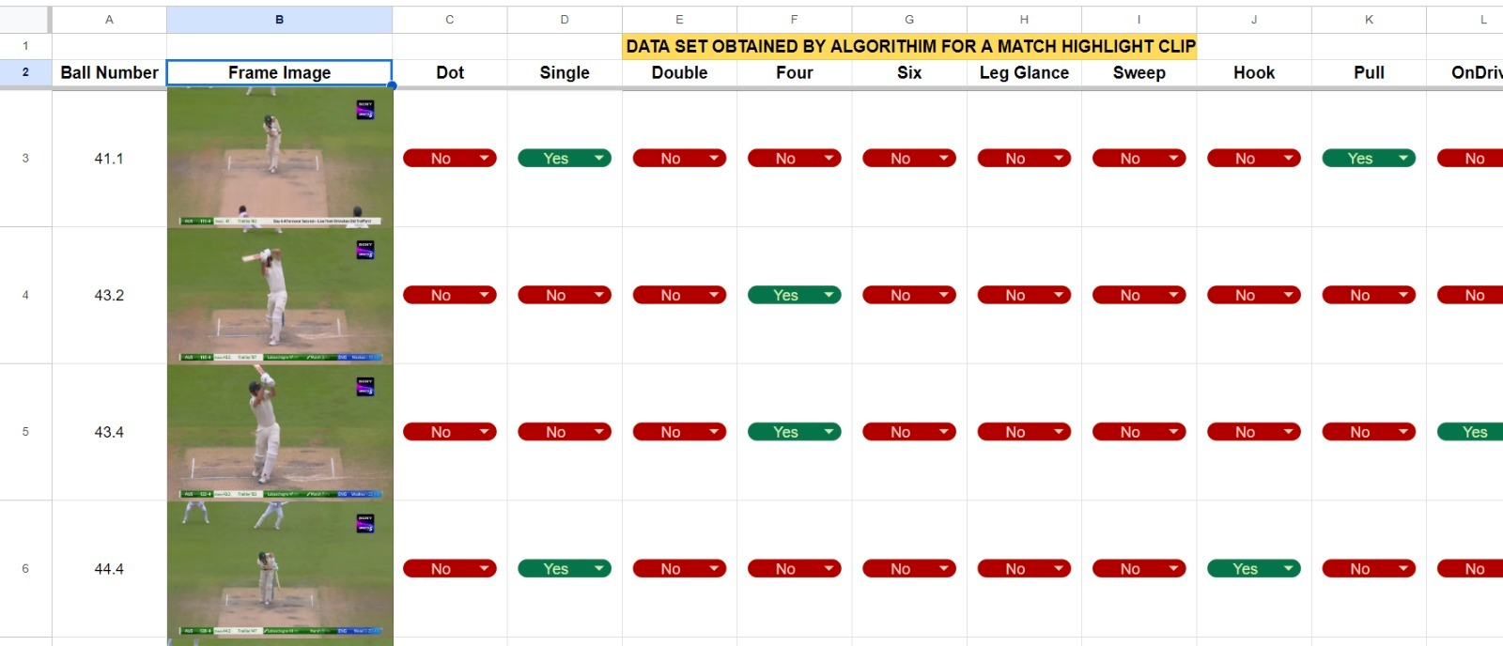
EXPECTED OUTPUT:

Slide 8
THANK YOU!

